Slide 1
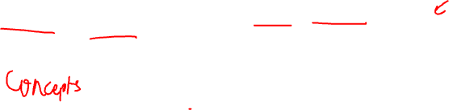
Linear Algebra for Data Science

Slide 2
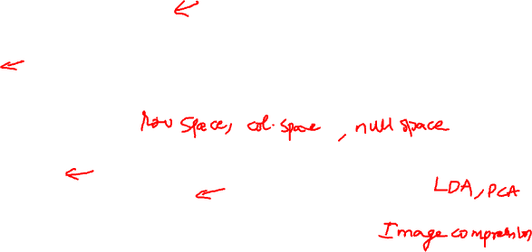
Outline
Vectors and Matrices for Data Science
Properties of Vectors
Properties of Matrices
Matrix Subspaces
Rank and Nullity
Eigenvalues and Eigenvectors
Singular Values, Singular Vectors and Singular Value Decomposition
Vector and Matrix properties applied to Data Science
Pre-requisites: Transpose, Determinant, Inverse and Multiplication of Matrices, and Types of matrices such as Identity, Symmetric, Diagonal, etc.

Slide 3
Vectors and Matrices for Data Science

Slide 4

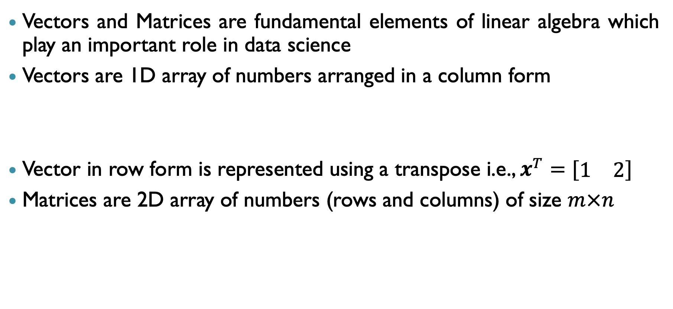

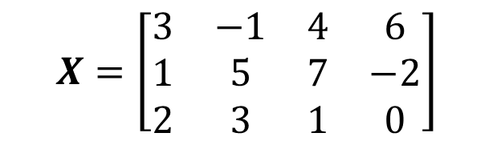
Vectors and Matrices
Vectors and Matrices are fundamental elements of linear algebra which play an important role in data science
Vectors are 1D array of numbers arranged in a column form
Vector in row form is represented using a transpose i.e., $x^{T}=[\begin{matrix}1 & 2\end{matrix}]$
Matrices are 2D array of numbers (rows and columns) of size $m×n$
$$x=\left[\begin{matrix}1 \\ 2\end{matrix}\right]$$
$$X=\left[\begin{matrix}3 & −1 & 4 & 6 \\ 1 & 5 & 7 & −2 \\ 2 & 3 & 1 & 0\end{matrix}\right]$$

Slide 5
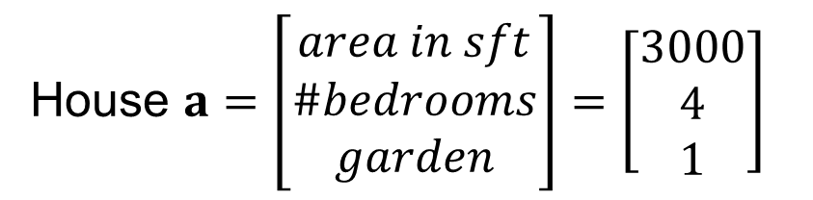
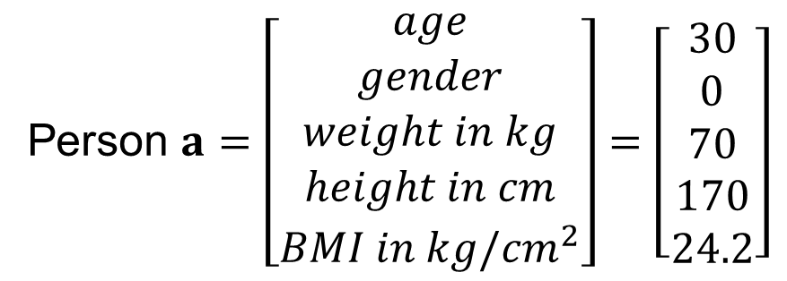
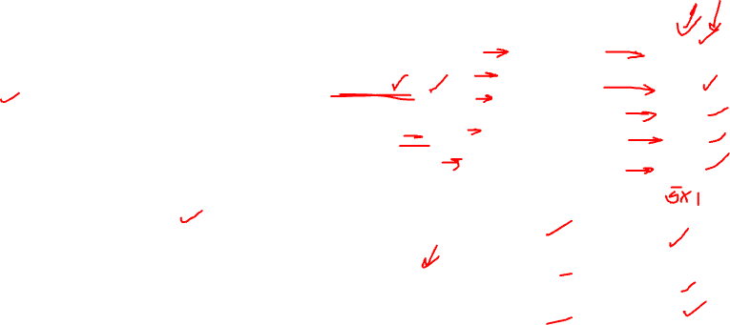
Vectors for Data representation
Vectors are useful to represent data which has more than one feature (variable)
Encode information in a format which ML models can process
Examples:
Vector containing features of a person: age, gender, weight, height, BMI, etc.
Vector containing features of a house: area, number of bedrooms, garden present or not, etc.
Person $a=\left[\begin{matrix}age \\ gender \\ weight in kg \\ height in cm \\ BMI in kg/{cm}^{2}\end{matrix}\right]=\left[\begin{matrix}30 \\ 0 \\ 70 \\ 170 \\ 24.2\end{matrix}\right]$
House $a=\left[\begin{matrix}area in sft \\ \#bedrooms \\ garden\end{matrix}\right]=\left[\begin{matrix}3000 \\ 4 \\ 1\end{matrix}\right]$

Slide 6

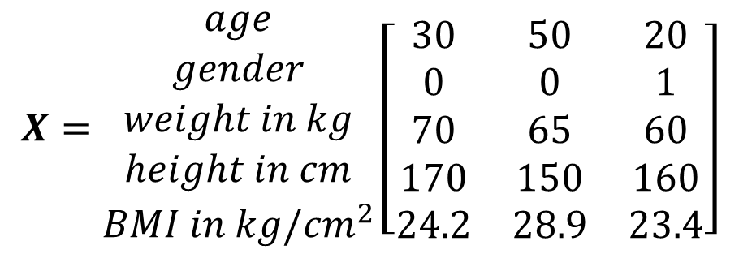
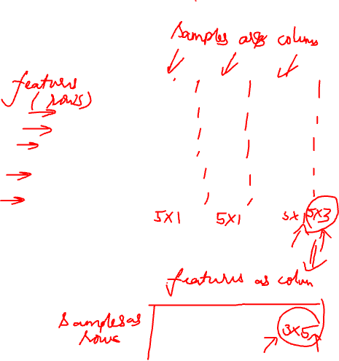
Matrices for Data representation
Generally, data contains multiple samples
Therefore, the features vectors are stacked together into a matrix
Feature vectors may be stacked as rows or columns of a matrix
Referred to as data matrix
When a data matrix is manipulated, the interpretation depends on the representation
$$\begin{matrix}\begin{aligned}Person \\ a\end{aligned} & \begin{aligned}Person \\ b\end{aligned} & \begin{aligned}Person \\ c\end{aligned}\end{matrix}$$
$$X=\begin{matrix}age \\ gender \\ weight in kg \\ height in cm \\ BMI in kg/{cm}^{2}\end{matrix}\left[\begin{matrix}30 & 50 & 20 \\ 0 & 0 & 1 \\ 70 & 65 & 60 \\ 170 & 150 & 160 \\ 24.2 & 28.9 & 23.4\end{matrix}\right]$$
Data Matrix with features (variables)
along rows and samples along columns

Slide 7
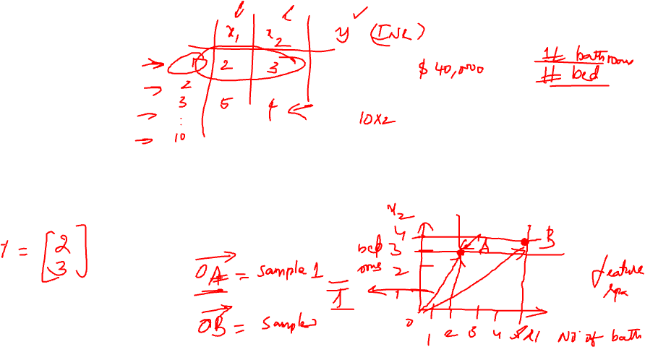
Algebraic Visualisation and Properties of Vectors

Slide 8
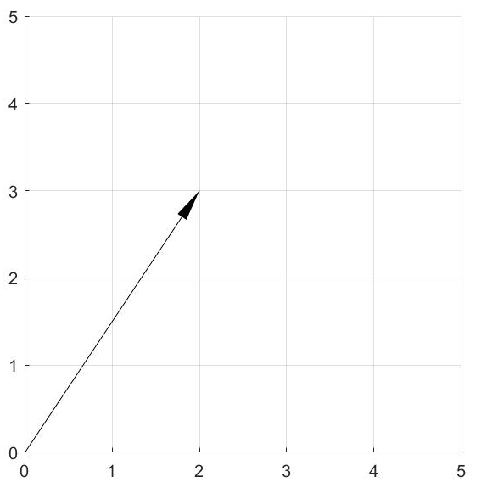

Vectors in Vector Space
2D Vector
Elements (components) of a vector can be represented in a coordinate space (Vector space)
Each element of the vector corresponds to a dimension in the vector space
Can be represented as an arrow or a point
$$x=\left[\begin{matrix}2 \\ 3\end{matrix}\right]$$

Slide 9
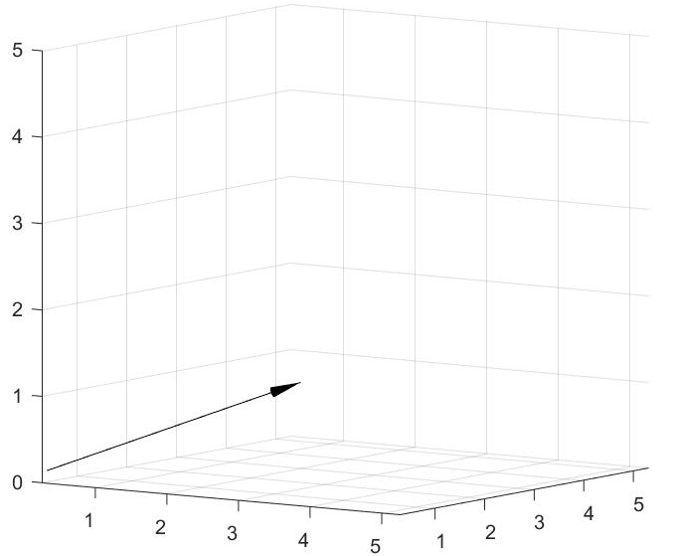

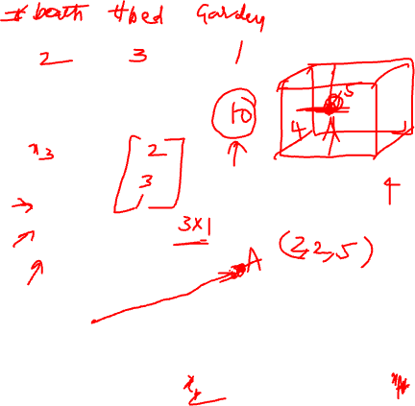
Vectors in Vector Space
3D Vector
Elements (components) of a vector can be represented in a coordinate space (Vector space)
Each element of the vector corresponds to a dimension in the vector space
Can be represented as an arrow or a point
$$x=\left[\begin{matrix}2 \\ 3 \\ 1\end{matrix}\right]$$

Slide 10

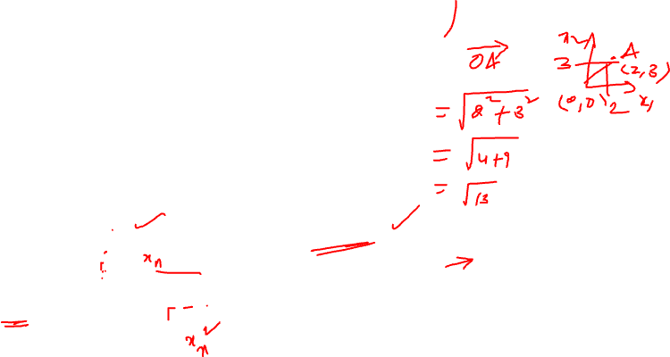
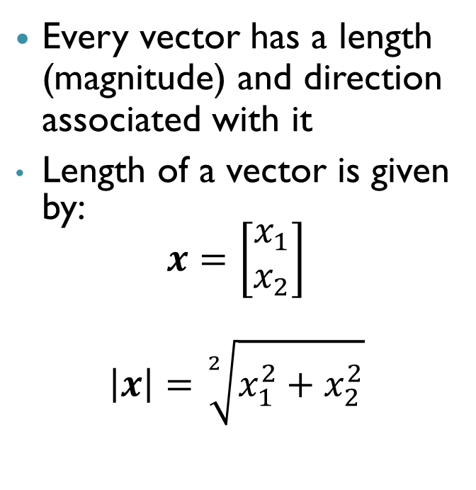

Length and Direction of Vectors
Length and Direction of a 2D Vector
Every vector has a length (magnitude) and direction associated with it
Length of a vector is given by:
$$x=\left[\begin{matrix}x_{1} \\ x_{2}\end{matrix}\right]$$
$$\left|x\right|=\sqrt[2]{x_{1}^{2}+x_{2}^{2}}$$
$$x=\left[\begin{matrix}2 \\ 3\end{matrix}\right]$$
$$|x|=\sqrt{13}$$

Slide 11

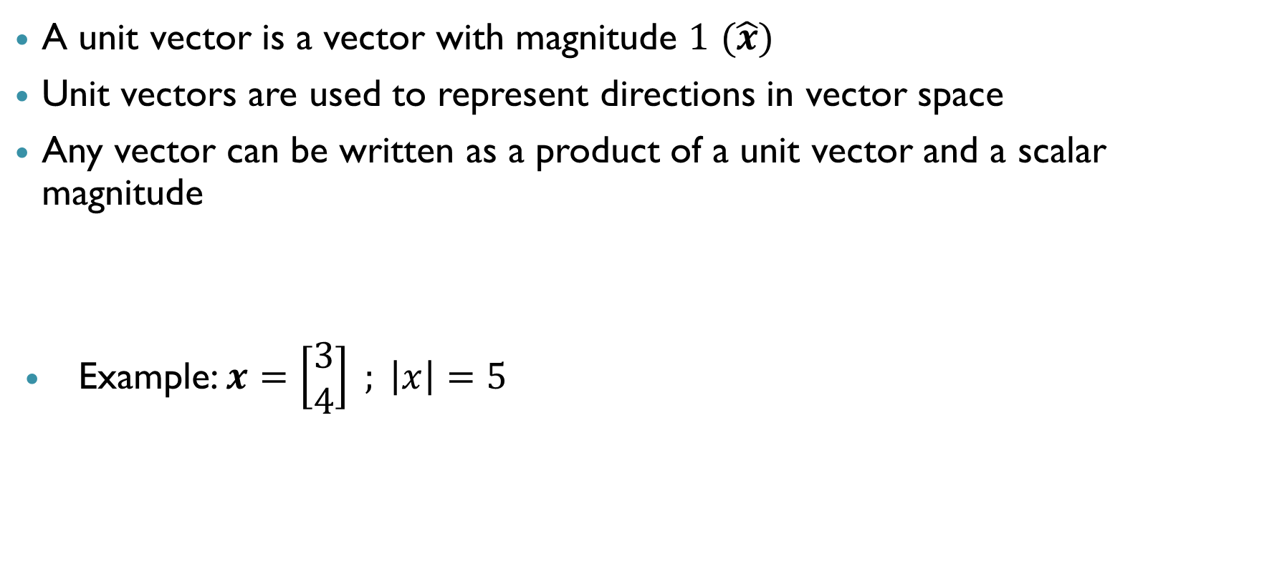
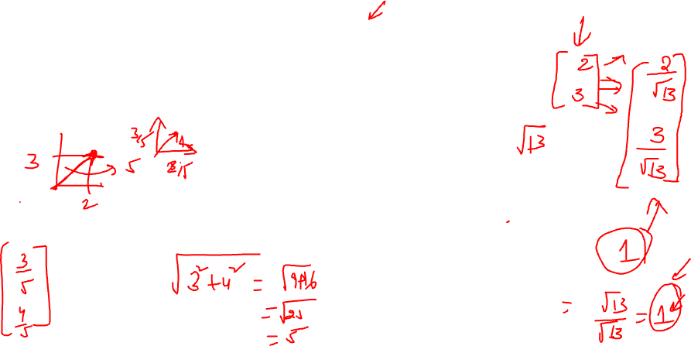

Unit vector
A unit vector is a vector with magnitude $1$ $(\hat{x})$
Unit vectors are used to represent directions in vector space
Any vector can be written as a product of a unit vector and a scalar magnitude
Example: $x=\left[\begin{matrix}3 \\ 4\end{matrix}\right] ; \left|x\right|=5$
$$\hat{x}=\frac{x}{\left|x\right|}$$
$$\hat{x}=\frac{x}{\left|x\right|}=\left[\begin{aligned}3/5 \\ 4/5\end{aligned}\right]$$

Slide 12
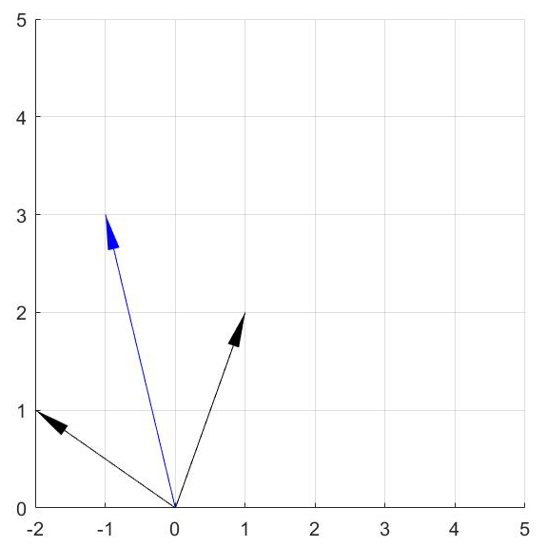
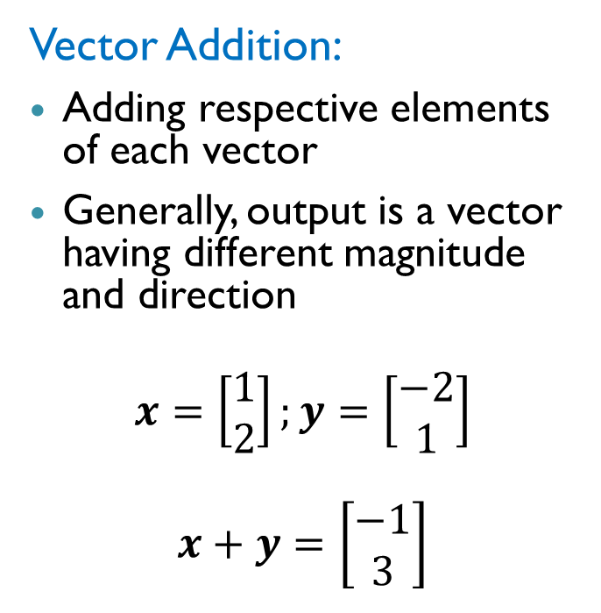
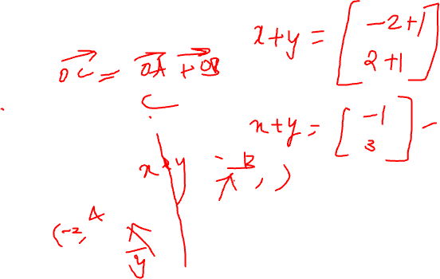
Properties of Vectors
2D Vector Addition
Vector Addition:
Adding respective elements of each vector
Generally, output is a vector having different magnitude and direction
$$x=\left[\begin{matrix}1 \\ 2\end{matrix}\right];y=\left[\begin{matrix}−2 \\ 1\end{matrix}\right]$$
$$x+y=\left[\begin{matrix}−1 \\ 3\end{matrix}\right]$$

Slide 13
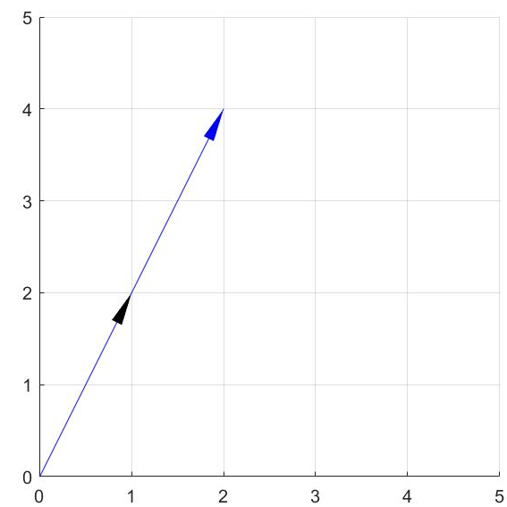
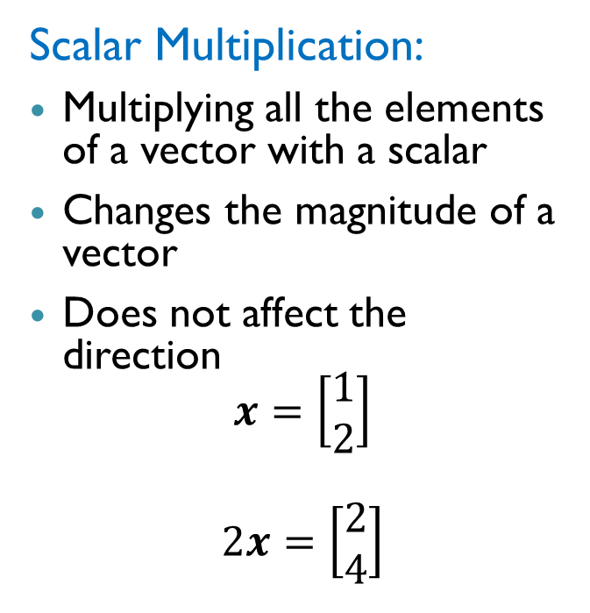
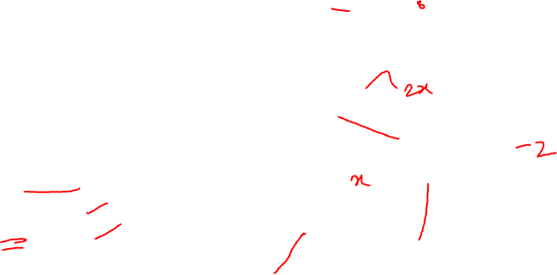
Properties of Vectors
Scalar Multiplication of 2D Vector
Scalar Multiplication:
Multiplying all the elements of a vector with a scalar
Changes the magnitude of a vector
Does not affect the direction
$$x=\left[\begin{matrix}1 \\ 2\end{matrix}\right]$$
$$2x=\left[\begin{matrix}2 \\ 4\end{matrix}\right]$$

Slide 14
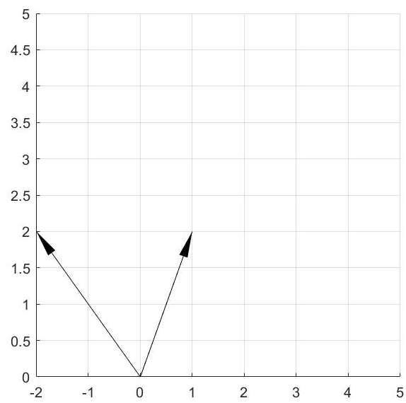
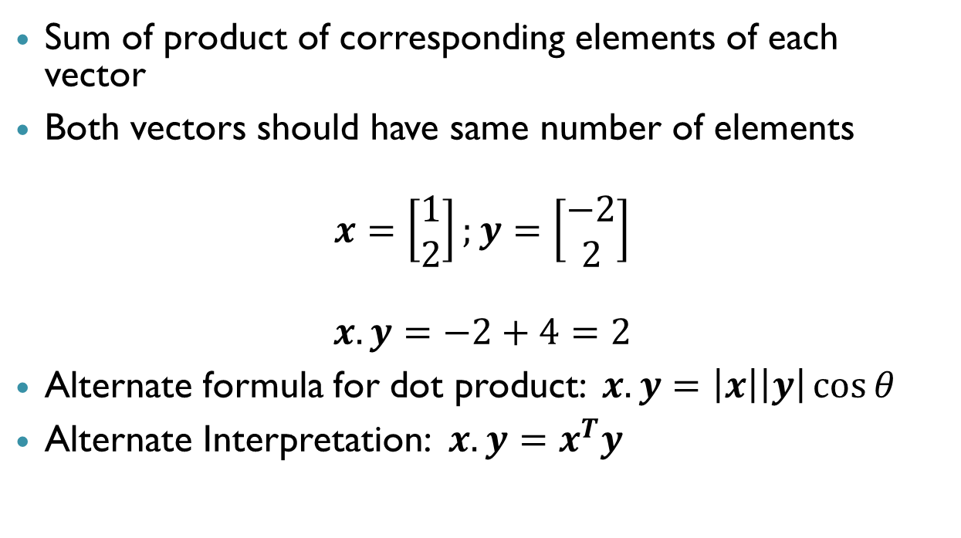
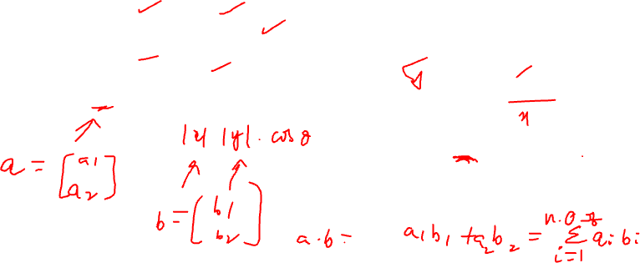

Properties of Vectors: Dot Product
Sum of product of corresponding elements of each vector
Both vectors should have same number of elements
$$x=\left[\begin{matrix}1 \\ 2\end{matrix}\right];y=\left[\begin{matrix}−2 \\ 2\end{matrix}\right]$$
$$x.y=−2+4=2$$
Alternate formula for dot product: $x.y=\left|x\right|\left|y\right|\cos{θ}$
Alternate Interpretation: $x.y=x^{T}y$
$$θ$$

Slide 15
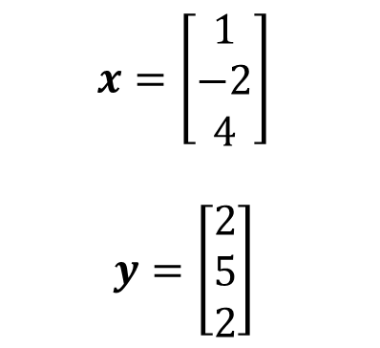
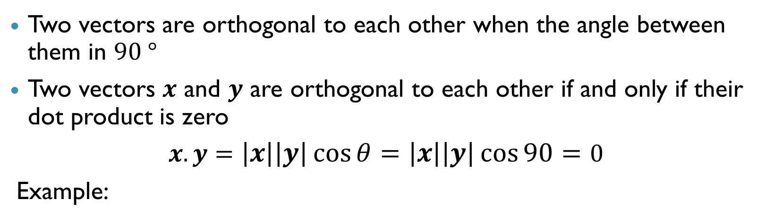
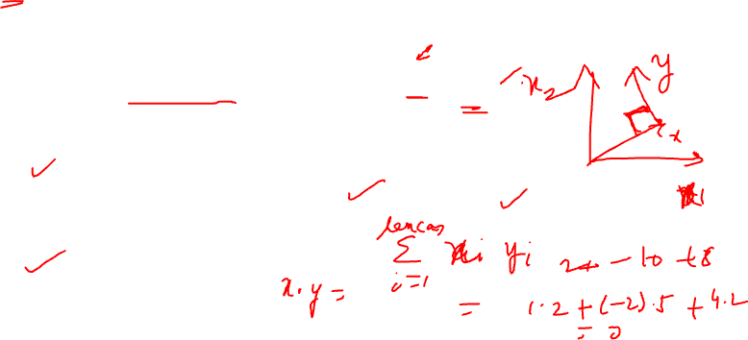

Orthogonal vectors
Two vectors are orthogonal to each other when the angle between them in $90 °$
Two vectors $x$ and $y$ are orthogonal to each other if and only if their dot product is zero
$x.y=\left|x\right|\left|y\right|\cos{θ}=\left|x\right|\left|y\right|\cos{90}=0$
Example:
$$x=\left[\begin{aligned}1 \\ −2 \\ 4\end{aligned}\right]$$
$$y=\left[\begin{aligned}2 \\ 5 \\ 2\end{aligned}\right]$$
$$x.y=2−10+8=0$$

Slide 16

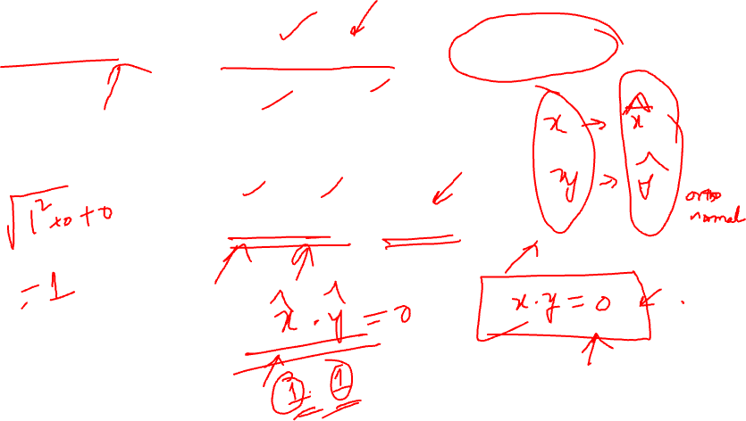
Orthonormal vectors
Orthonormal vectors are orthogonal vectors with unit magnitude
Example
$$x=\left[\begin{matrix}1 \\ 0 \\ 0\end{matrix}\right] ;y=\left[\begin{matrix}0 \\ 1 \\ 0\end{matrix}\right]$$
$\left|x\right|=\left|y\right|=1 ;x.y=0$

Slide 17
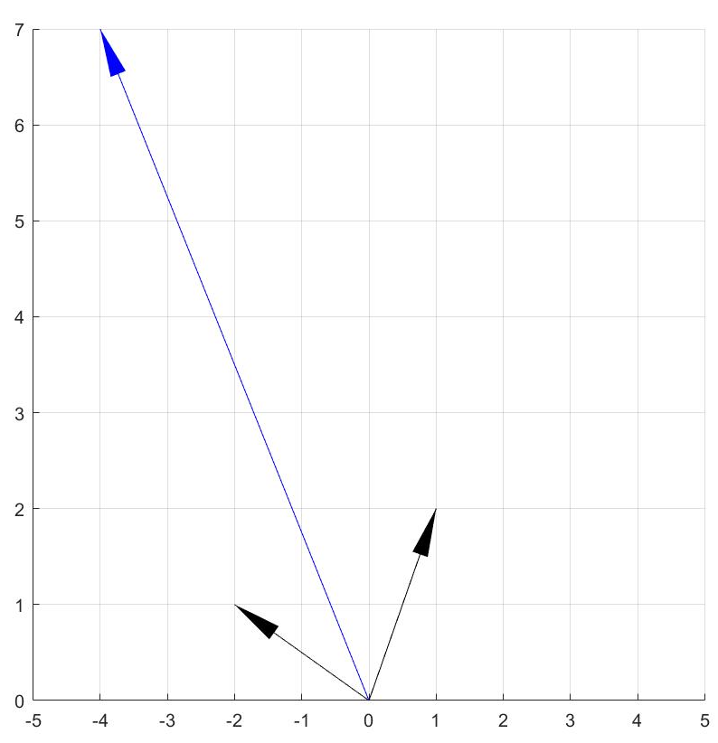
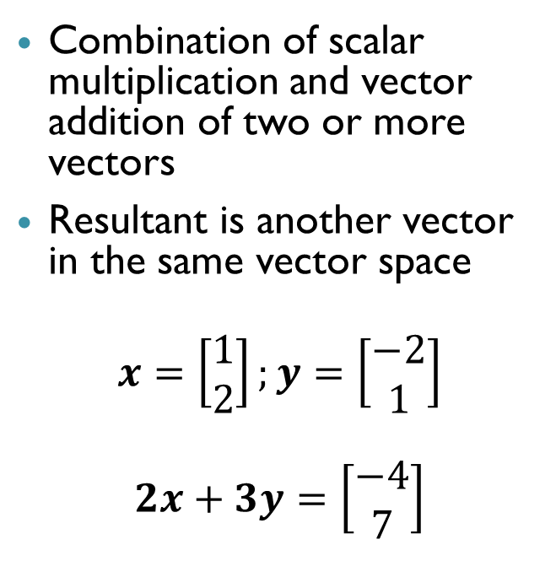
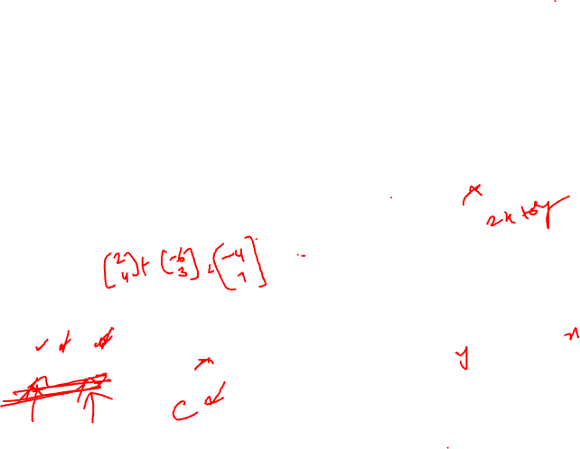
Linear Combination of Vectors
Linear Combination of 2D Vectors
Combination of scalar multiplication and vector addition of two or more vectors
Resultant is another vector in the same vector space
$$x=\left[\begin{matrix}1 \\ 2\end{matrix}\right];y=\left[\begin{matrix}−2 \\ 1\end{matrix}\right]$$
$$2x+3y=\left[\begin{matrix}−4 \\ 7\end{matrix}\right]$$

Slide 18
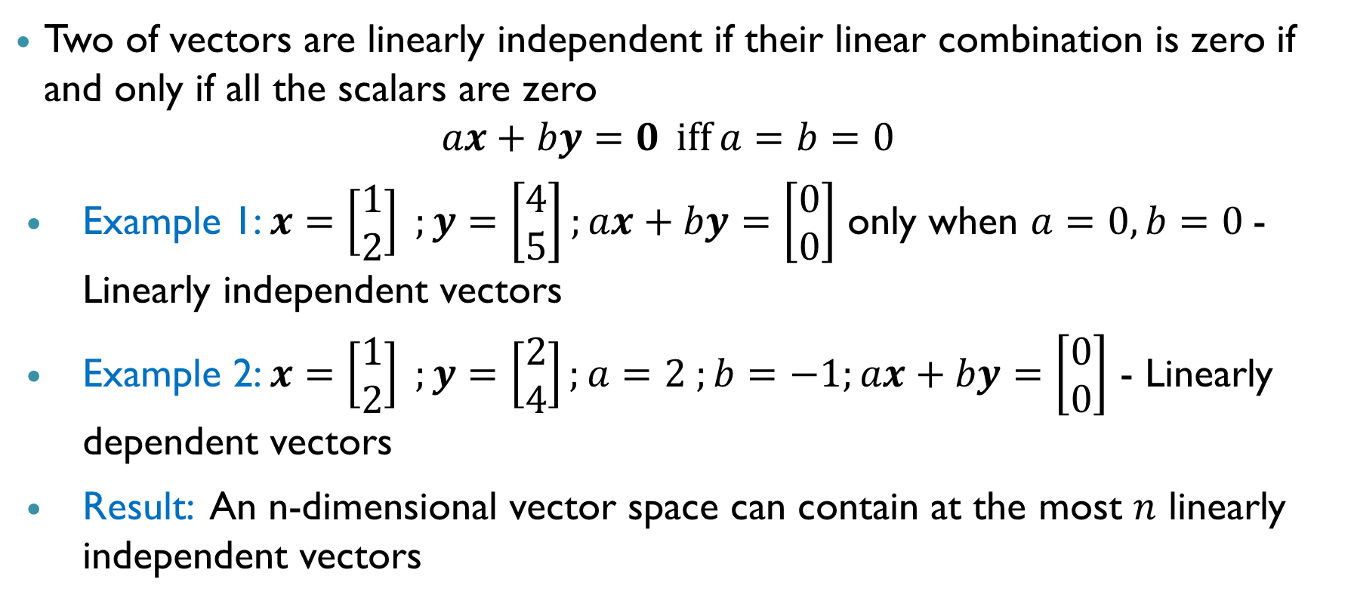
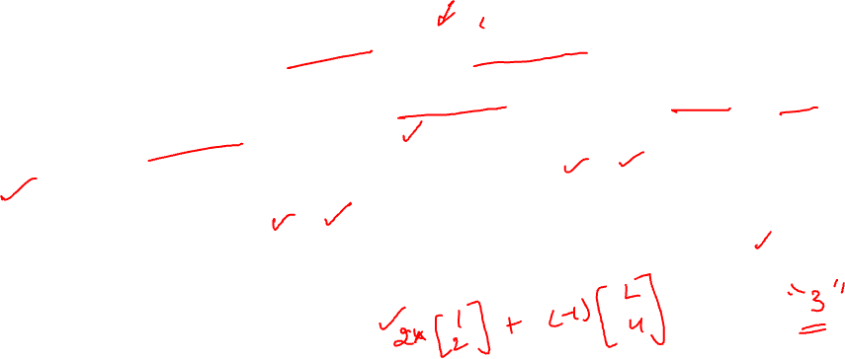
Linearly Independent Vectors
Two of vectors are linearly independent if their linear combination is zero if and only if all the scalars are zero
$$ax+by=0 \operatorname{iff}{a=b=0}$$
Example 1: $x=\left[\begin{matrix}1 \\ 2\end{matrix}\right] ;y=\left[\begin{matrix}4 \\ 5\end{matrix}\right];ax+by=\left[\begin{matrix}0 \\ 0\end{matrix}\right]$ only when $a=0,b=0$- Linearly independent vectors
Example 2: $x=\left[\begin{matrix}1 \\ 2\end{matrix}\right] ;y=\left[\begin{matrix}2 \\ 4\end{matrix}\right];a=2 ;b=−1;ax+by=\left[\begin{matrix}0 \\ 0\end{matrix}\right]$ - Linearly dependent vectors
Result: An n-dimensional vector space can contain at the most $n$ linearly independent vectors

Slide 19
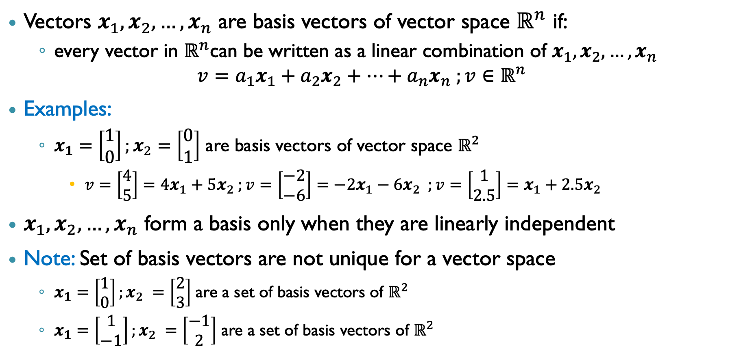
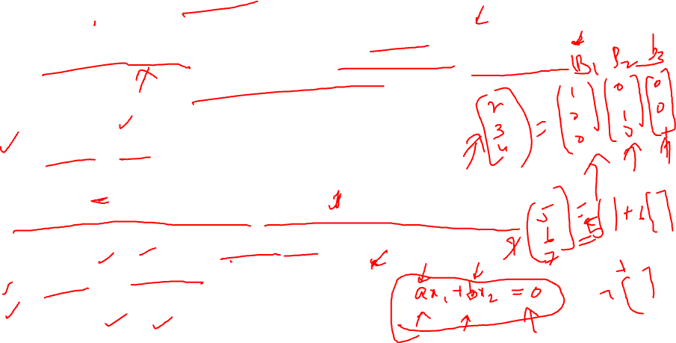
Basis vectors (Basis for a Vector Space)
Vectors $x_{1},x_{2},…,x_{n}$ are basis vectors of vector space $ℝ^{n}$ if:
every vector in $ℝ^{n}$can be written as a linear combination of $x_{1},x_{2},…,x_{n}$
$$v=a_{1}x_{1}+a_{2}x_{2}+…+a_{n}x_{n} ;v∈ℝ^{n}$$
Examples:
$x_{1}=\left[\begin{matrix}1 \\ 0\end{matrix}\right];x_{2}=\left[\begin{matrix}0 \\ 1\end{matrix}\right]$ are basis vectors of vector space $ℝ^{2}$
$v=\left[\begin{matrix}4 \\ 5\end{matrix}\right]=4x_{1}+5x_{2} ;v=\left[\begin{matrix}−2 \\ −6\end{matrix}\right]=−2x_{1}−6x_{2} ;v=\left[\begin{matrix}1 \\ 2.5\end{matrix}\right]=x_{1}+2.5x_{2}$
$x_{1},x_{2},…,x_{n}$ form a basis only when they are linearly independent
Note: Set of basis vectors are not unique for a vector space
$x_{1}=\left[\begin{matrix}1 \\ 0\end{matrix}\right];x_{2} =\left[\begin{matrix}2 \\ 3\end{matrix}\right]$ are a set of basis vectors of $ℝ^{2}$
$x_{1}=\left[\begin{matrix}1 \\ −1\end{matrix}\right];x_{2} =\left[\begin{matrix}−1 \\ 2\end{matrix}\right]$ are a set of basis vectors of $ℝ^{2}$

Slide 20
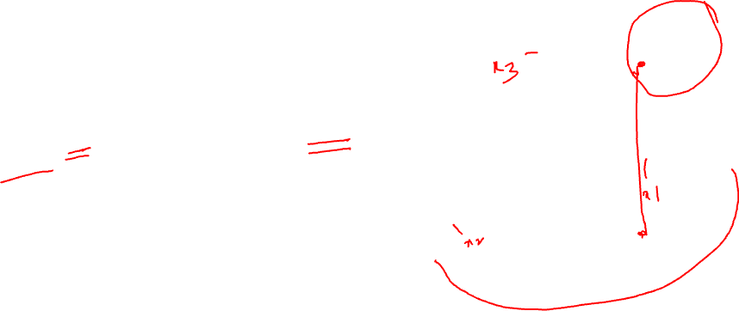
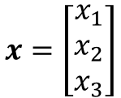
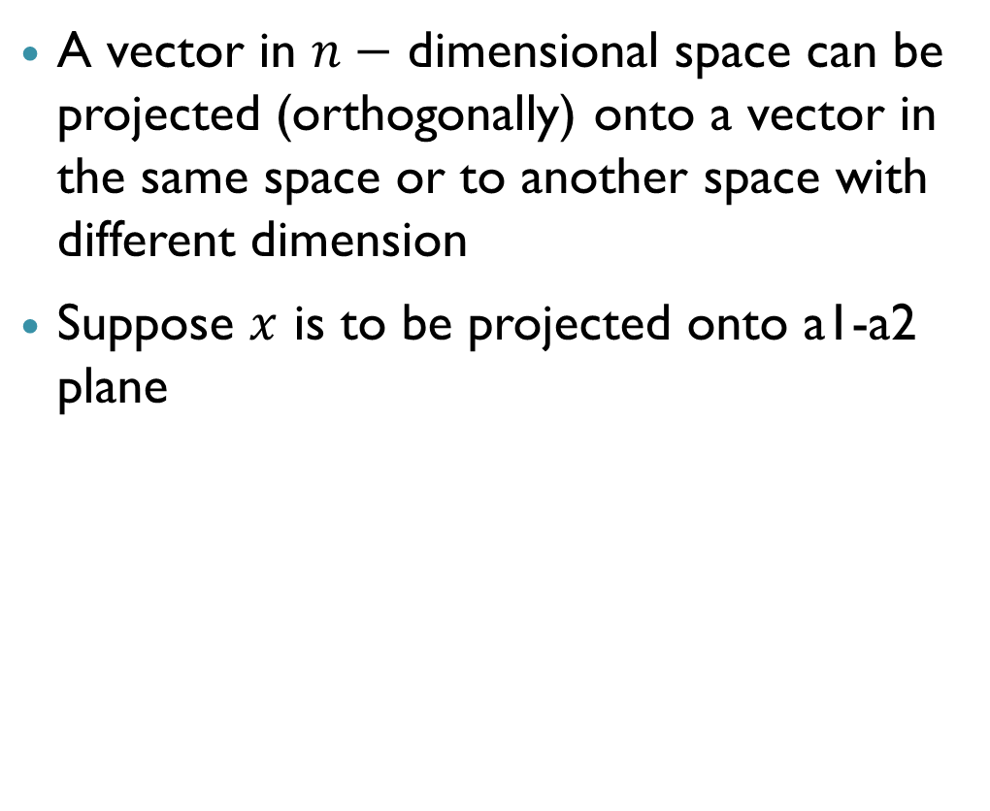



Projection of a Vector
$$a3$$
A vector in $n−$ dimensional space can be projected (orthogonally) onto a vector in the same space or to another space with different dimension
Suppose $x$ is to be projected onto a1-a2 plane
$$x=\left[\begin{matrix}x_{1} \\ x_{2} \\ x_{3}\end{matrix}\right]$$
$$a1$$
$$a2$$

Slide 21
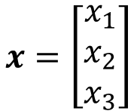
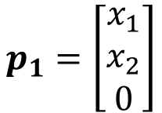
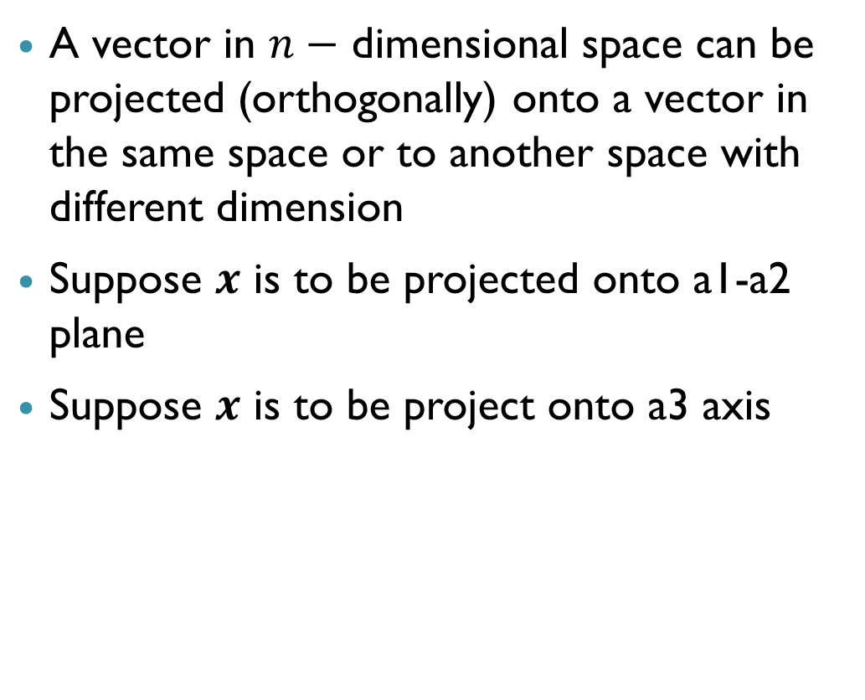

Projection of a Vector
$$a3$$
A vector in $n−$ dimensional space can be projected (orthogonally) onto a vector in the same space or to another space with different dimension
Suppose $x$ is to be projected onto a1-a2 plane
Suppose $x$ is to be project onto a3 axis
$$x=\left[\begin{matrix}x_{1} \\ x_{2} \\ x_{3}\end{matrix}\right]$$
$$a1$$
$$p_{1}=\left[\begin{matrix}x_{1} \\ x_{2} \\ 0\end{matrix}\right]$$
$$a2$$

Slide 22
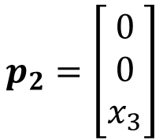
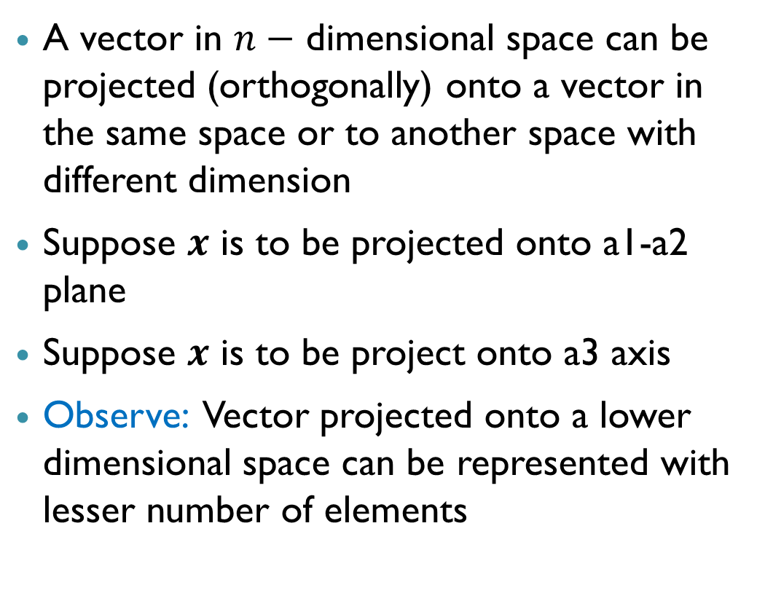
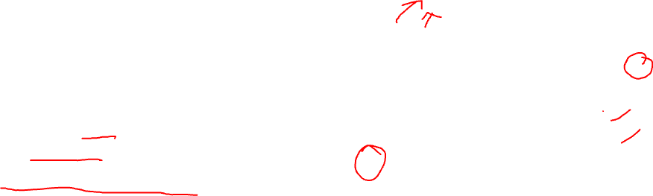
Projection of a Vector
$$a3$$
A vector in $n−$ dimensional space can be projected (orthogonally) onto a vector in the same space or to another space with different dimension
Suppose $x$ is to be projected onto a1-a2 plane
Suppose $x$ is to be project onto a3 axis
Observe: Vector projected onto a lower dimensional space can be represented with lesser number of elements
$$p_{2}=\left[\begin{matrix}0 \\ 0 \\ x_{3}\end{matrix}\right]$$
$$x=\left[\begin{matrix}x_{1} \\ x_{2} \\ x_{3}\end{matrix}\right]$$
$$a1$$
$$p_{1}=\left[\begin{matrix}x_{1} \\ x_{2} \\ 0\end{matrix}\right]$$
$$a2$$

Slide 23
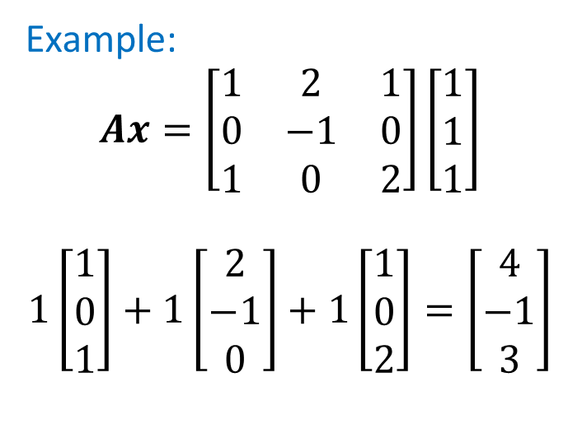


Matrix Multiplication with a Vector
To multiply a matrix $(A)$ with a vector $(x)$, # columns of $A$ should be equal to the number of elements in $x$
Interpretation: Linear combination of columns of $A$ and results in another vector $(c)$
Let $a_{1},a_{2},…a_{n}$ be the columns of $A$
$$Ax=\left[a_{1} a_{2} …a_{n}\right]\left[\begin{matrix}x_{1} \\ x_{2} \\ ⋮ \\ x_{n}\end{matrix}\right]$$
$$Ax=x_{1}a_{1}+x_{2}a_{2}+…+x_{n}a_{n}=c$$
Note: Number of elements in $c$ is equal to the number of rows in $A$
Example:
$$Ax=\left[\begin{matrix}1 & 2 & 1 \\ 0 & −1 & 0 \\ 1 & 0 & 2\end{matrix}\right]\left[\begin{matrix}1 \\ 1 \\ 1\end{matrix}\right]$$
$$1\left[\begin{matrix}1 \\ 0 \\ 1\end{matrix}\right]+1\left[\begin{matrix}2 \\ −1 \\ 0\end{matrix}\right]+1\left[\begin{matrix}1 \\ 0 \\ 2\end{matrix}\right]=\left[\begin{matrix}4 \\ −1 \\ 3\end{matrix}\right]$$

Slide 24








Matrix Multiplication with a Vector
Alternate Interpretation: Transformation of a vector $x$ into another vector $c=Ax$
Like a function which maps an input vector to an output vector
If $A$ is a square matrix $(n×n)$, then $Ax$ is a vector in the same vector space $(ℝ^{n})$ – scales and rotates
If $A$ is a rectangular matrix $(m×n)$, then $Ax$ is a vector in a different vector space $(ℝ^{m})$
$f:ℝ^{n}→$ $ℝ^{m}$
$$ℝ^{n}$$
$$ℝ^{m}$$
$$Ax=c$$
$$x$$
$$c$$

Slide 25












Matrix Multiplication with a Vector
$$A=\left[\begin{matrix}1 & −2 \\ 1 & 1\end{matrix}\right]$$
$$A=\left[\begin{matrix}1 & −2 \\ 1 & 1 \\ 0 & 3\end{matrix}\right]$$
$$c=Ax=\left[\begin{matrix}−4 \\ 5\end{matrix}\right]$$
$$c=Ax=\left[\begin{matrix}−3 \\ 3 \\ 6\end{matrix}\right]$$
$$x=\left[\begin{matrix}2 \\ 3\end{matrix}\right]$$
$$x=\left[\begin{matrix}1 \\ 2\end{matrix}\right]$$
$$ℝ^{2}$$
$$ℝ^{3}$$

Slide 26
Properties of Matrices

Slide 27



Matrix Subspaces: Column space or Image
Column space of a matrix $A$ is the vector subspace containing all linear combinations of columns of $A$
For $m×n$ matrix $A,$ the column space $𝒞(A)$ comprises of all vectors
Basis: Linearly independent columns of $A$ form a basis for the column space of $A$
Dimension of $𝒞\left(A\right):$ Equal to the number of linear independent columns of $A$
Example:
$$Ax=\left[\begin{matrix}1 & 2 & 1 \\ 0 & −1 & 0 \\ 1 & 0 & 2\end{matrix}\right]\left[\begin{matrix}1 \\ 1 \\ 1\end{matrix}\right]=\left[\begin{matrix}4 \\ −1 \\ 3\end{matrix}\right]$$
$$Ax=\left[\begin{matrix}1 & 2 & 1 \\ 0 & −1 & 0 \\ 1 & 0 & 2\end{matrix}\right]\left[\begin{matrix}1 \\ 0 \\ 1\end{matrix}\right]=\left[\begin{matrix}2 \\ 0 \\ 3\end{matrix}\right]$$
$\left[\begin{matrix}4 \\ −1 \\ 3\end{matrix}\right],\left[\begin{matrix}2 \\ 0 \\ 3\end{matrix}\right],…$ lie in the $𝒞(A)$
$$c=Ax ∀ x∈ℝ^{n}$$

Slide 28




Matrix Subspaces: Null space or Kernel
Null space of a matrix $A$ is subspace containing vectors $x$ such that
Trivial null space: If the columns of $A$ are linearly independent, then the null space contains only the zero vector
Example:
$$Ax=\left[\begin{matrix}1 & 2 & 2 \\ 0 & −1 & 0 \\ 1 & 0 & 2\end{matrix}\right]\left[\begin{matrix}2 \\ 0 \\ −1\end{matrix}\right]=\left[\begin{matrix}0 \\ 0 \\ 0\end{matrix}\right]$$
$$Ax=\left[\begin{matrix}1 & 2 & 2 \\ 0 & −1 & 0 \\ 1 & 0 & 2\end{matrix}\right]\left[\begin{matrix}4 \\ 0 \\ −2\end{matrix}\right]=\left[\begin{matrix}0 \\ 0 \\ 0\end{matrix}\right]$$
$\left[\begin{matrix}2 \\ 0 \\ −1\end{matrix}\right],\left[\begin{matrix}4 \\ 0 \\ −2\end{matrix}\right],…$ lie in the $𝒩\left(A\right)$
$$𝒩\left(A\right)=x∈ℝ^{n}|Ax=0$$

Slide 29



Matrix Subspaces: Row Space
Row space of a matrix $A$ is the vector subspace containing all linear combinations of rows of $A$
For $m×n$ matrix $A,$ the row space $ℛ(A)$ comprises of all vectors
Basis: Linearly independent rows of $A$ form a basis for the row space of $A$
Dimension of $ℛ(A)$: Equal to the number of linear independent rows of $A$
$$r=A^{T}y ∀ y∈ℝ^{m}$$

Slide 30


Rank and Nullity of a Matrix
Rank is the Number of linearly independent rows or columns of a matrix $A$
Dimension of the column space and row space are equal to the rank of a matrix
$$r=rank\left(A\right)=\dim{𝒞(A)}=\dim{ℛ(A)}≤\min{(m,n)}$$
Nullity is the dimension of the null space of a matrix
Nullity$(A)=\dim{𝒩(A)}$
Nullity is zero if the null space contains only the zero vector

Slide 31


Rank of a matrix: Example
Consider
$$A=\left[\begin{matrix}1 & 2 & 1 \\ 2 & 4 & 0 \\ 3 & 6 & 0\end{matrix}\right]$$
Observe that
(Col. 2)=2 x (Col. 1)
Col. 1 and Col 3 are independent
Col. 2 and Col 3 are independent
Thus, the rank of this matrix is 2
What is the rank of $A=\left[\begin{matrix}1 & 2 \\ 2 & 4 \\ 3 & 6\end{matrix}\right]$ and $A=\left[\begin{matrix}1 & 1 \\ 2 & 0 \\ 3 & 0\end{matrix}\right]$?

Slide 32


Full Rank Matrix
Matrix is said to have full rank when it rank is equal to the number of rows or number of columns of the matrix
$$r=rank\left(A\right)=\min{(m,n)}$$
A $m×m$ square matrix has full rank when: $r=m$
Rank deficient matrix: A matrix not having full rank

Slide 33


Results relating Matrix Subspaces
Rank-Nullity Theorem:
For an $m×n$ matrix $A:$
$rank\left(A\right)+nullity\left(A\right)=n$
Fundamental theorem of Linear Algebra:
Null space of a matrix is orthogonal to its row space: $𝒩\left(A\right)=ℛ{\left(A\right)}^{⊥}$

Slide 34


Determinant, Inverse, Singularity and Rank of a Square Matrix
Consider a square matrix $A$ of size $m×m$
Following statements are equivalent:
$\det{A}≠0$
$A$ is invertible
$r=rank\left(A\right)=m$
$A$ has $m$ linearly independent rows and $m$ linearly independent columns
$A$ is a non-singular matrix
$nullity \left(A\right)=0$ and null space contains only the zero vector
Note: All the converse statements are also equivalent

Slide 35
Eigenvectors and Eigenvalues

Slide 36







Eigenvectors and Eigenvalues
Let $A$ be a square matrix
Recall: $Ax$ transforms vector $x$ into a new vector having a different magnitude (scaled) and direction
Question: Are there vectors which do not change direction when multiplied by $A$?
Eigenvectors: Special vectors which do not change direction but only scale in magnitude when transformed by A
Scaling factor is referred to as eigenvalue $(λ)$
$$A=\left[\begin{matrix}1 & 2 \\ 2 & 1\end{matrix}\right]$$
$$Ax=\left[\begin{matrix}3 \\ 3\end{matrix}\right]=3\left[\begin{matrix}1 \\ 1\end{matrix}\right]$$
$$x=\left[\begin{matrix}1 \\ 1\end{matrix}\right]$$
$$Ax=λx$$

Slide 37


Properties of Eigenvalues and Eigenvectors
Let $λ_{1},…,λ_{m}$ be set of eigenvalues and $x_{1},…,x_{m}$ be corresponding eigenvectors of a square matrix $A$
Following are some of their properties:
Set of eigenvalues are unique for a matrix but $x_{i}$ is not unique for a given $λ_{i}$
$$A(αx)=λ(αx)$$
If $λ_{1},…,λ_{m}$are distinct, then $x_{1},…,x_{m}$are linearly independent
$λ_{1}λ_{2}…λ_{m}=\det{A}$
$λ_{1}+λ_{2}+…+λ_{m}=$ Sum of diagonal elements of $A$ (trace)
Number of non-zero eigenvalues is equal to the rank of the matrix

Slide 38
Singular Values and Singular Vectors

Slide 39


Singular Values and Singular Vectors
Recall: Eigenvalues and eigenvectors are defined only for square matrices
Question: Can something similar to eigenvalues and vectors be defined for any matrix in general (square or rectangular)?
$σ$ is a singular value and $u$ and $v$ are corresponding singular vectors (unit vectors) of a matrix $A$ of size $m×n$ if:
$$Av=σu$$
$$A^{T}u=σv$$
$u$: Left singular vector of size $m$ ; $v$: Right singular vector of size $n$
For any matrix $A,$ there always exist combinations of $u,v,σ$ which satisfy the above condition

Slide 40

Properties of Singular values and Singular vectors
Let $σ_{1},σ_{2}…$ be the set of singular values and $u_{1},u_{2}…$ and $v_{1},v_{2},…$ be corresponding pairs of singular vectors of a matrix $A$
Following are some of their properties:
Set of singular values are unique but $u_{i}$ and $v_{i}$ is not unique for a given $σ_{i}$
Number of non-zero singular values is equal to the rank of the matrix
Set of vectors $u_{1},u_{2},…$ are orthogonal (or orthonormal) and set of vectors $v_{1},v_{2},…$ are orthogonal (or orthonormal)

Slide 41











Interpretation of Singular values and Singular vectors
Interpretation: A set of orthonormal vectors $(v_{1},v_{2},…)$ in an input space get mapped to a set of orthonormal vectors $(u_{1},u_{2},…)$ in an output space
Example:
$$A=\left[\begin{matrix}1 & 0 & 1 \\ 0 & 2 & 0\end{matrix}\right];u=\left[\begin{matrix}0 \\ 1\end{matrix}\right];v=\left[\begin{matrix}0 \\ 1 \\ 0\end{matrix}\right];σ=2$$
$$Av=σu$$
$$\left[\begin{matrix}1 & 0 & 1 \\ 0 & 2 & 0\end{matrix}\right]\left[\begin{matrix}0 \\ 1 \\ 0\end{matrix}\right]=2\left[\begin{matrix}0 \\ 1\end{matrix}\right]$$
$f:ℝ^{n}→$ $ℝ^{m}$
$$ℝ^{m}$$
$$ℝ^{n}$$
$$Av=σu$$
$$v$$
$$u$$
$$v$$
$$u$$
$$A^{T}u=σv$$
$$A^{T}u=σv$$
$$\left[\begin{matrix}1 & 0 \\ 0 & 2 \\ 1 & 0\end{matrix}\right]\left[\begin{matrix}0 \\ 1\end{matrix}\right]=2\left[\begin{matrix}0 \\ 1 \\ 0\end{matrix}\right]$$

Slide 42
Singular Value Decomposition

Slide 43



Singular Value Decomposition (SVD)
Any $m×n$ matrix $A$ can be factorized (decomposed) into three matrices based on singular values and singular vectors
Columns of $U$: Left singular vectors $u$
Columns of $V$: Right singular vectors $v$
Matrix $S$ has singular values $(σ)$ of $A$ along the main diagonal
Note:
Left singular vectors have same direction as eigen vectors of $AA^{T}$
Right singular vectors have same direction as eigen vectors of $A^{T}A$
$$A_{m×n} =U_{m×m}S_{m×n}V_{n×n}^{T }$$

Slide 44



Singular Value Decomposition - Example
Example:
$A=$
SVD of $A$ is given by:
$A$ =
U
$$S$$
V^{T}

Slide 45

Summary
Vectors representation in a vector space
Vectors properties of magnitude, direction, addition, scaling and dot product
Linear combination and linear independence of vectors
Basis of a vector space
Projection and Matrix multiplication of a vector
Matrix subspaces- column space, null space and row space
Rank and nullity of a matrix

Slide 46

Summary – Cont…
Eigenvalues and Eigenvectors of a matrix
Singular values and Singular vectors of a matrix
Singular Value Decomposition
What is the relevance of these concepts in relation to Data Science?

Slide 47
Vector and Matrix Properties Applied to Data Matrix

Slide 48





Finding Number of Independent Features
Suppose among the $m$ features only $k$ of them are independent while the rest are dependent (linearly)
Implies: $m−k$ features can be determined from the $k$ independent features
$m$ features
$k$ independent features
$m−k$ dependent features

Slide 49


Finding Number of Independent Features
Suppose among the $m$ features only $k$ of them are independent while the rest are dependent (linearly)
Implies: $m−k$ features can be determined from the $k$ independent features
Question: How to determine the value of $k$ from data matrix?
Here, each feature is a row and all features are not independent ($X$ is rank deficient)
Number of independent features is equal to the number of linearly independent rows in the matrix
Implies: Number of independent features $=$ $rank(X)$
Note: Interpretation changes if the features are along the columns

Slide 50







Dimensionality Reduction
Feature $3$
Suppose there are too many features in the dataset
Question: How to reduce the number of features without losing information?
Answer: Project the feature vectors to a lower dimension space
$$p_{2}=\left[\begin{matrix}0 \\ 0 \\ x_{3}\end{matrix}\right]$$
$$x=\left[\begin{matrix}x_{1} \\ x_{2} \\ x_{3}\end{matrix}\right]$$
Feature $1$
$$p_{1}=\left[\begin{matrix}x_{1} \\ x_{2} \\ 0\end{matrix}\right]$$
Feature $2$

Slide 51

Dimensionality Reduction
Suppose there are too many features in the dataset
Question: How to reduce the number of features without losing information?
Answer: Project the feature vectors to a lower dimension space
Question: Which space to project and what is its basis ?
Answer: Find a space in which maximum information is retained when the vectors are projected
Basis of such a space can be obtained from Singular Value Decomposition (Singular vectors corresponding to high singular values)
Note: Whether left or right singular vectors are to be used depends on whether the features are along rows or columns

Slide 52


Eigenvalues and eigenvectors: Examples
Consider the following example with the given A matrix
$$A=\left[\begin{matrix}8 & 7 \\ 2 & 3\end{matrix}\right]$$
$$\left[\begin{matrix}8 & 7 \\ 2 & 3\end{matrix}\right]\left[\begin{aligned}x_{1} \\ x_{2}\end{aligned}\right]=λ\left[\begin{aligned}x_{1} \\ x_{2}\end{aligned}\right]=\left[\begin{aligned}{λx}_{1} \\ {λx}_{2}\end{aligned}\right]$$
$$\left|A−λI\right|=\left|\left[\begin{matrix}8 & 7 \\ 2 & 3\end{matrix}\right]−λ\left[\begin{matrix}1 & 0 \\ 0 & 1\end{matrix}\right]\right|=\left|\left[\begin{matrix}8−λ & 7 \\ 2 & 3−λ\end{matrix}\right]\right|=0$$
$$\left(8−λ\right)\left(3−λ\right)−14=0$$
$$λ^{2}−11λ+10=0$$
$$λ=(10,1)$$
Thus we identify two eigenvalues and now we proceed to find the corresponding eigenvectors

Slide 53


Eigenvalues and eigenvectors: Examples
$$\left[\begin{matrix}8 & 7 \\ 2 & 3\end{matrix}\right]\left[\begin{aligned}x_{1} \\ x_{2}\end{aligned}\right]=λ\left[\begin{aligned}x_{1} \\ x_{2}\end{aligned}\right]$$
$λ=1$
$$\left[\begin{matrix}8 & 7 \\ 2 & 3\end{matrix}\right]\left[\begin{aligned}x_{1} \\ x_{2}\end{aligned}\right]=\left[\begin{aligned}x_{1} \\ x_{2}\end{aligned}\right]$$
$$\left[\begin{aligned}{8x}_{1}+7x_{2} \\ 2x_{1}+3x_{2}\end{aligned}\right]=\left[\begin{aligned}x_{1} \\ x_{2}\end{aligned}\right]$$
$$x_{1}+x_{2}=0$$
Thus the eigenvector (unit) corresponding to $λ=1$is
$$X=\left[\begin{aligned}\frac{1}{\sqrt{2}} \\ \frac{−1}{\sqrt{2}}\end{aligned}\right]$$

Slide 54


Eigenvalues and eigenvectors: Examples
$λ=10$
$$\left[\begin{matrix}8 & 7 \\ 2 & 3\end{matrix}\right]\left[\begin{aligned}x_{1} \\ x_{2}\end{aligned}\right]=\left[\begin{aligned}{10x}_{1} \\ {10x}_{2}\end{aligned}\right]$$
$$\left[\begin{aligned}{8x}_{1}+7x_{2} \\ 2x_{1}+3x_{2}\end{aligned}\right]=\left[\begin{aligned}10x_{1} \\ {10x}_{2}\end{aligned}\right]$$
$$7x_{2}=2x_{1}$$
Thus the eigenvector (unit) corresponding to $λ=10$
$$X=\left[\begin{aligned}\frac{7}{\sqrt{53}} \\ \frac{2}{\sqrt{53}}\end{aligned}\right]$$

Slide 55

Singular Value Decomposition
Example:
For a matrix A = To factorize A as A = UΣV^{T}
To find U:
AA^{T} = ; eigenvalues = 4, 2
Eigen vectors of AA^{T} = for the eigenvalue 4 and for the eigenvalue 2
To make the vectors orthonormal, divide them by its length, which will
give and ; U =

Slide 56


Singular Value Decomposition
To find V:
A^{T}A = ; eigenvalues = 4, 2, 0
Eigenvectors of A^{T}A = for the eigenvalue 4 , for the eigenvalue 2
and for the eigenvalue 0
To make the vectors orthonormal, divide them by its length, which will
give , and ; V =

Slide 57

Singular Value Decomposition
The diagonal matrix Σ takes the square root of the nonzero eigenvalues
Σ =
So, we have,
A =
U
Σ
V^{T}

Slide 58

Singular Value Decomposition
Example:
For a matrix A = To factorize A as A = UΣV^{T}
To find U:
AA^{T} = ; eigenvalues = 3, 1, 0
Eigenvectors of AA^{T} = for the eigenvalue 3 , for the eigenvalue 1
and for the eigenvalue 0

Slide 59

Singular Value Decomposition
To make the vectors orthonormal, divide them by its length, which will
give , and
⇒ U =

Slide 60

Singular Value Decomposition
To find V:
A^{T}A = ; eigenvalues = 3, 1
Eigenvectors of A^{T}A = for the eigenvalue 3 and for the eigenvalue 1
To make the vectors orthonormal, divide them by its length, which will
give and ; V =

Slide 61

Singular Value Decomposition
The diagonal matrix Σ takes the square root of the nonzero eigenvalues
Σ =
So, we have,
A =
U
Σ
V^{T}

Slide 62

THANK YOU

